Slide 1

IETF Hackathon:
MEF EVC Service YANG Models in Unimgr Project of ODL
IETF 102
14-15 July, 2018
Montreal

Slide 2
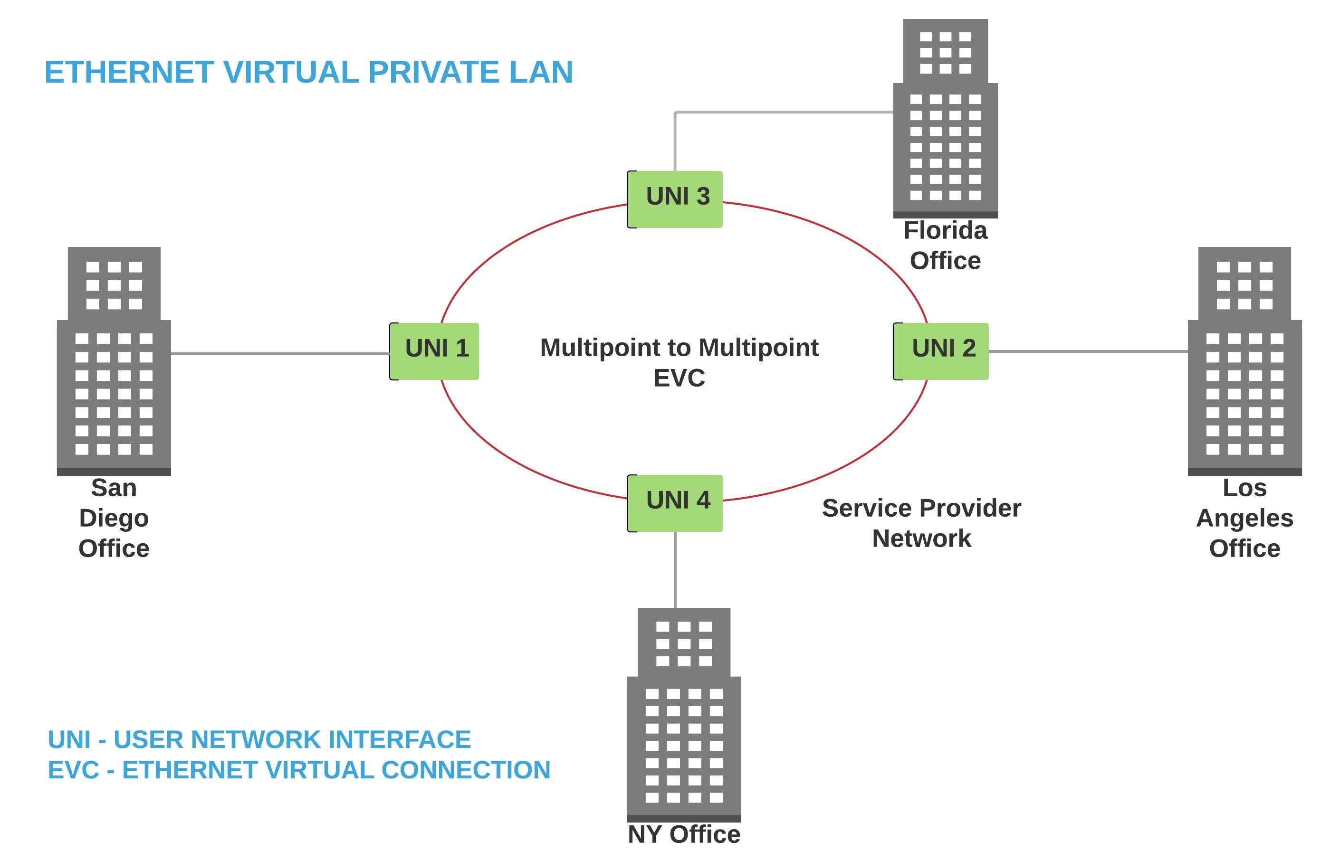
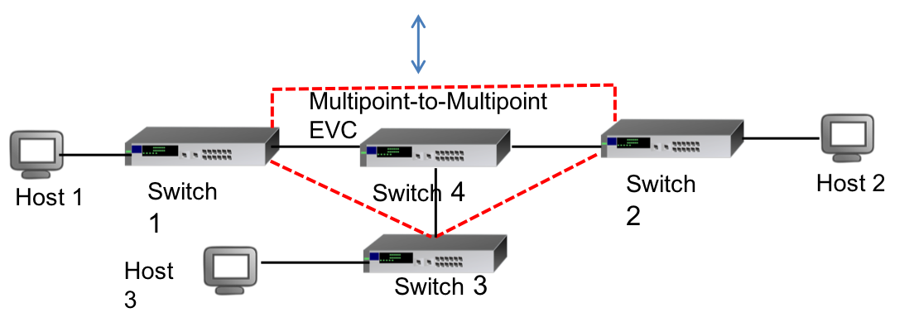
Hackathon Plan
Implementing EVC Services
E-Line services in London
MEF 6.2 and MEF 10.3
Trying to get E-LAN services working
KISS

Slide 3
What got done
Have E-LAN services running
Kind of
All port LAN service – EPLAN
VLAN based service - EVPLAN
https://github.com/santanude/unimgr/tree/demo
From P2P to M2M service. Replication in the PE node
Link to test results will be posted later
Link to demo will be posted later

Slide 4
What we learned
Specifying a range or set of values is a problem
RFC 7950 (YANG 1.1) allows a value
VLANs can be a range or set of values (1-4094)
Need a way to specify a range or set of values
Nice to have

Slide 5
Wrap Up
Team members:
Mahesh Jethanandani (mjethanandani@gmail.com)
Kiran Ambardekar (Kiran.Ambardekar@Xoriant.Com)
Santanu De (santanu.de@Xoriant.Com)
Shrinvas Joshi (shrinivas.joshi@Xoriant.Com)
First timers @ IETF/Hackathon:
Legato - EVC Services YANG (https://www.mef.net/Assets/Technical_Specifications/PDF/MEF_58.pdf)
EVC Ethernet Services Definitions (https://www.mef.net/Assets/Technical_Specifications/PDF/MEF_6.2.pdf)
Ethernet Service Attributes https://www.mef.net/Assets/Technical_Specifications/PDF/MEF_10.3.pdf

